Slide 1
TA 111: Technical Arts
2023-24 II
Lecture 15
Space Geometry – I
Dr. Syam Nair
Department of Civil Engineering
IIT Kanpur
Office: FB 307
Phone: 6424
Email: syamnair@iitk.ac.in

Slide 2
Reading: Lines and Planes
Thomas E. French, “Engineering Drawing and Graphics Technology”
Chapter 9, Auxiliary Views: Lines and Planes Explored

Slide 3
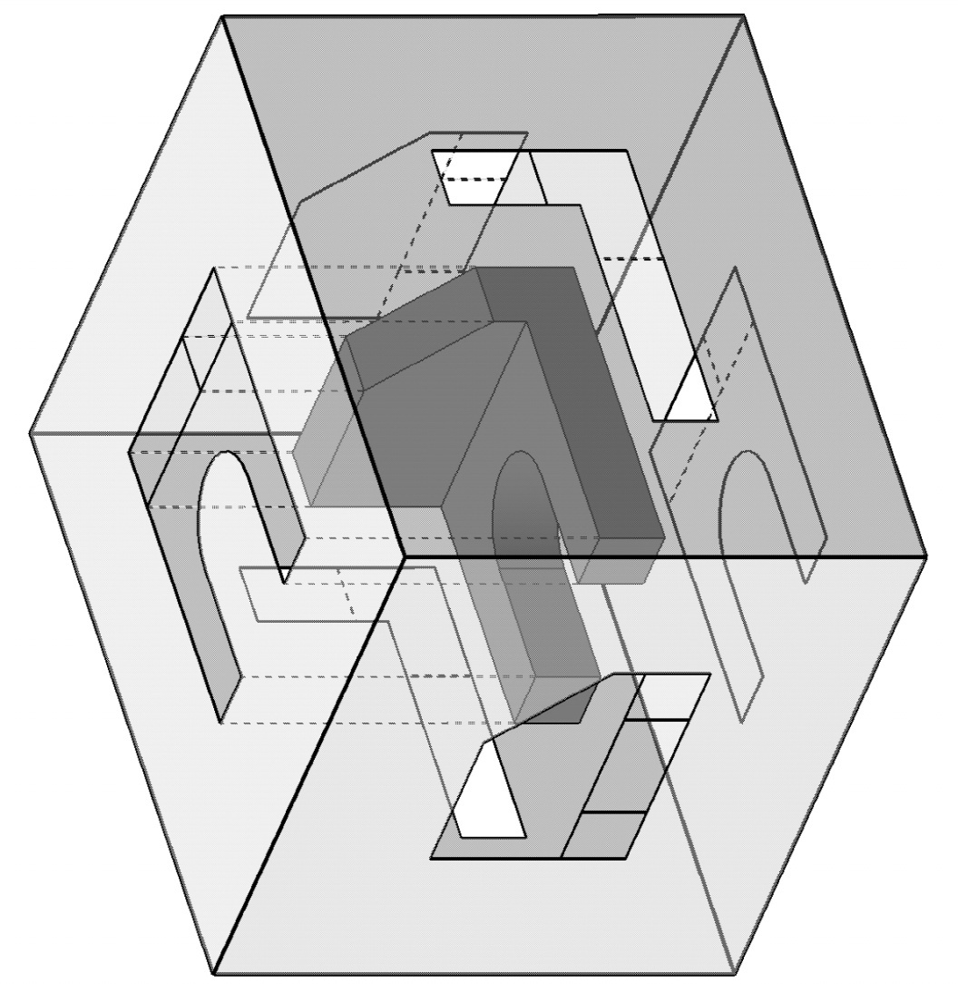
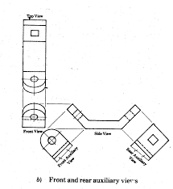
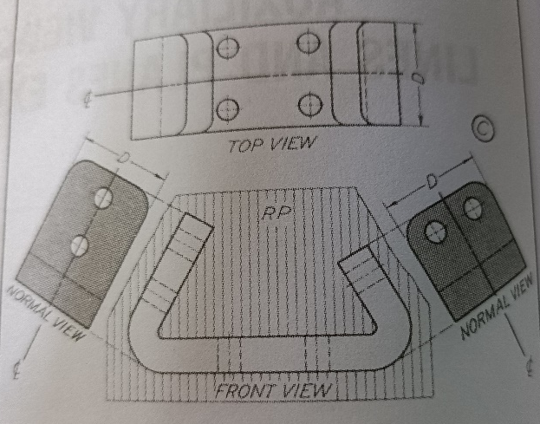
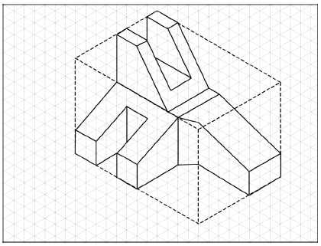
Recall: Glass box method for Orthographic
Auxiliary view: Orthographic view that is
not Horizontal, Frontal or Profile view
https://www.google.com/search?tbm=isch&sxsrf=ACYBGNRA9RsCirCxUqDDXXCTaXO1n-oBnA:1569477526770&q=image+that+needs+auxiliary+planes+in+orthographic&chips=q:image+that+needs+auxiliary+planes+in+orthographic,online_chips:primary+auxiliary+views&usg=AI4_-kRCSmNNAwSRiTJ_L6-j-_1Gwvz5sA&sa=X&ved=0ahUKEwiy3tyz5-3kAhWBNI8KHUQnAVkQ4lYIMCgD&biw=1707&bih=749&dpr=1.13#imgrc=kpZ_ViVytvJ_QM:

Slide 4
Normal View or True Shape
Term ‘Normal’ means ‘perpendicular’ or at ‘right angles’
Normal View is one in which the ‘direction of sight’ is perpendicular to a line/plane
Normal View of a line shows the True Length of the line
Normal View of a plane shows the True Shape of the plane
Normal View may or may not be captured in one of the principal orthographic views/projections

Slide 5
A Line in Space
Consider Line AB
a_{H}
HP
b_{H}
P
C
A
FVP
a_{F}
Q
a_{P}
B
TL
b_{P}
R
b_{F}
PVP

Slide 6
A Line in Space
Consider Line AC
a_{H}
TL
c_{H}
HP
Q
P
C
A
c_{P}
FVP
a_{F}
B
a_{P}
c_{F}
PVP

Slide 7
A Line in Space
Consider Line BC
c_{H}
HP
b_{H}
A
C
c_{P}
FVP
TL
c_{F}
B
Q
b_{P}
P
b_{F}
PVP

Slide 8
Point View of a Line
Point view of a line appears when the line of sight is parallel to the line
In point view, the line appears as a single point
Point views are very useful in solving many problems in space geometry

Slide 9
Edge View
An ‘Edge View’ of a plane is that view, which shows the plane as a ‘line’.
The ‘direction of sight’ should be parallel to the plane in an Edge View (EV)
EV
H.P.
F.P.
P.P.
True Shape
EV

Slide 10
Space Geometry Terminology
In order to describe an object completely, one needs to be able to perform one or more of the following tasks
  Find the ‘Point View’ (PV) of a line
  Find the ‘Normal View’ of a line
  Find the ‘True Length (TL)’ of a line
  Find the ‘Edge View (EV)’ of a plane
  Find the ‘Normal View’ of a plane
  Find the True Size and Shape of a surface
  Find angle between lines and planes
  Find spacing between ‘elements’ of an object

Slide 11
Point View
A Line lying on two principal planes of projection will appear in NORMAL VIEW (i.e., in TRUE LENGTH) in two views, and as a POINT VIEW (PV) in the third view
N
(H.P.)
PV
(H.P.)
N
(F.P.)
N
PV
N
N
N
(P.P.)
(F.P.)
PV
(P.P.)
Horizontal-Frontal
Horizontal - Profile
Frontal- Profile

Slide 12
Important Observations: Lines
TL?
TL?
TL
PV
TL
H.P.
F.P.
TL?
TL?
TL?
TL
TL
P.P.
PV
PV
TL
TL

Slide 13






Finding True Length of a Line
Direct Formula
= 0
Y
TL
X
Z
X

Slide 14



Finding True Length of a Line
Direct Formula
= 0
Y
(x₂, y₂, z₂)
X
Z
(x₁, y₁, z₁)
TL
X

Slide 15
4-Step Procedure for Normal View/True Length of an ‘oblique line’
Determine desired line of sight
  LOS is perpendicular to one of the projections of the line (equivalent to one walking around in space until desired line of sight is obtained)
Establish a new projection plane (called Auxiliary Plane A) perpendicular to the line of sight
  Place at a convenient distance parallel to the line
Project all points of the object (two points of the oblique line in this case) into the new view (A)
  Use principles of orthographic projections
Locate points on the object (points A & B of an oblique line) along the projections in auxiliary plane

Slide 16
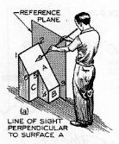
Auxiliary Views – Viewing Direction

Slide 17
Auxiliary Views: Observations
Given a projected line in Plane – 1
  True length can be obtained on Plane – 2 which is kept in direction normal (at 90^{O}) to the projected line
  By using the distances various points of the original line from Plane – 1
P1 – H
P2 – F

Slide 18
A Point in Space
P_{T}
Q_{T}
Horizontal Plane
d
d1
H.P.
h
V.P.
h1
P
d
h
Q_{F}
Vertical Plane
P_{F}

Slide 19
Auxiliary Views: Observations
Horizontal Plane
Q (d, h2)
h1
Q_{H}
P
P_{H}
d
d
Vertical Plane
H.P.
Q_{T}
P_{T}
F.P.
h2
h1
Q_{F}
d
d
TL?
H.P.
P_{F}
V.P.
h2
h1
Q_{F}
P_{F}

Slide 20
Auxiliary Views: Observations
Similarly, for an oblique line (given the projections of the line in Plane – 1 and Plane – 2)
  True length can be obtained on Plane – 3 which is kept in direction normal (at 90^{O}) to the projected line on Plane – 2
  By using the distances various points of the original line from Plane – 1
P1 – H
P2 – F
P3 - Aux

Slide 21
Auxiliary Plane: Concept
Direction perpendicular to
the same plane is always
the same direction in space
Auxiliary plane
d₂
H
d₁
A_{H}
B_{H}
A_{A}
TL
A
B_{A}
H
d₁
F
A_{F}
d₂
A_{A}
B
F
A_{A}
TRUE LENGTH(TL)
B_{A}
B_{F}
P
A
B_{A}
LINE
OF
SIGHT
Notice the distances from the hinge lines

Slide 22
Auxiliary Plane: Concept
for an oblique line (given the projections of the line in Plane – 1 and Plane – 2)
  True length can be obtained on Plane – 3 which is kept in direction normal (at 90^{O}) to the projected line on Plane – 2
  By using the distances various points of the original line from Plane – 1
d1
d1
b_{H}
H
PV
A1
d
b_{A2,} a_{A2}
a_{H}
Line of Sight
b_{A1}
A2
TL
A1
H
F
d
a_{A1}
a_{F}
b_{F}
Notice the direction of Projectors
Notice the distance Measurements along Projectors

Slide 23
Auxiliary Plane: Concept
B_{H}
A_{H}
d
H
P
F
B_{P}
B_{F}
d
F
A1
A_{P}
A_{F}
B_{A1}
d1
TL
Notice the direction of Projectors
d1
A_{A1}
PV
Notice the distance Measurements along Projectors
A1
A_{A2} ,B_{A2}
A2

Slide 24
Thank you !!!

